Slide 1
S-102 Status Brief
S-100 TS-2 (19 – 21 SEP 2017)
TSM5-7.1
David W Brazier, US Navy
Janice Eisenberg, NOAA

Slide 2
S-102 Project Team Areas of Focus
Project Team effort since S-100WG2 (March 2017):
Finalize Portrayal
Describe Gridding Methodology
Define Grid Resolution Guidance
Finalize File Size Limit Guidance
Investigate Use of a Tiling Scheme
Finalize Coordinate Reference System
Generate an Actual S-102 Dataset
Establish path for variable-resolution gridding (Fall 2017)
Project Team Milestone:
Finalize S-102 v2.0 for submission to HSSC9 (May 2018).

Slide 3
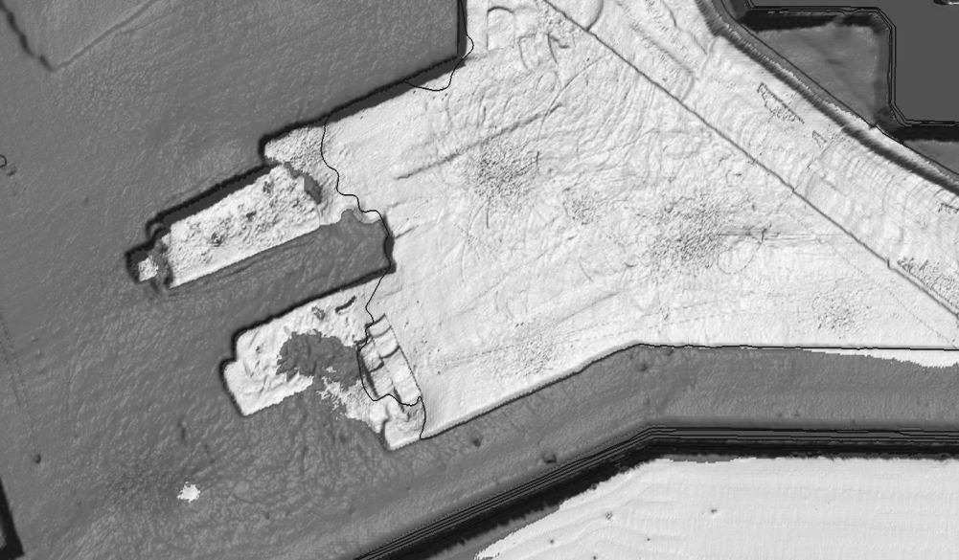
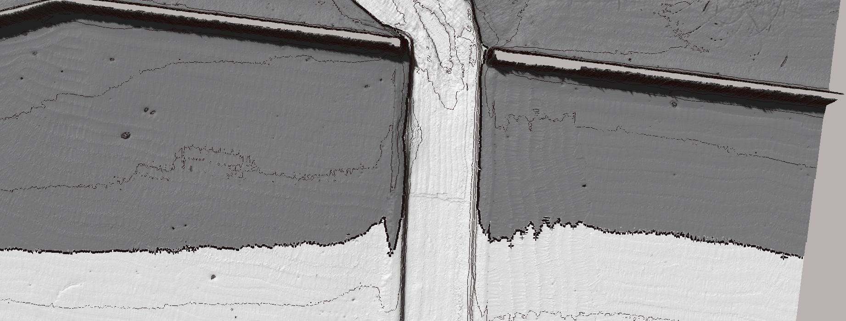

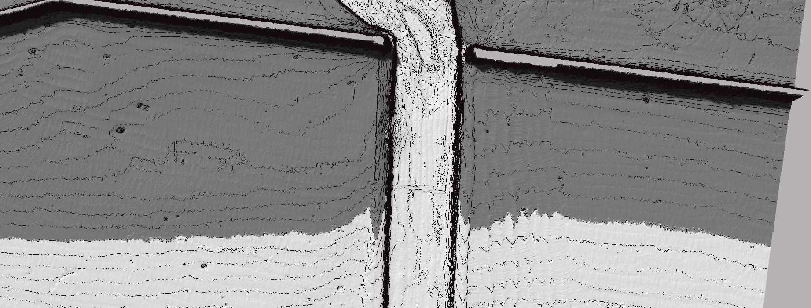
S-102 Portrayal (Options Proposed at S-100 WG2)
Depth/Uncert. from Cursor
18₂
18₉
15₄
18₃
9₆
19₁
18₂
19₃
19₁
18₂
18₂
18₂
15₅
15₂
Auto Selected Soundings
Depth: 19.2
Uncertainty: 0.11
- Safe/Unsafe Colouring
- Auto Generated Safety Contour
UNSAFE
19m Safety Contour
SAFE
Auto Generated Contours

Slide 4



S-102 Portrayal (Post S-100 WG2)
Rejected Portrayal
Accepted Portrayal
15₄
18₃
9₆
18₂
19₁
18₉
18₂
19₃
19₁
18₂
18₂
18₂
15₅
Auto Selected Soundings
15₂
Unsafe
Auto Generated Contours
Depth: 19.2
Uncert: 0.11
Safe
Auto Safety Contour
Potential legal issues with automated routines executed by mariner.
Current automated functions still require hydrographer interaction.
Delineation of safe (white) and unsafe (grey) water based on mariner input parameters.
Ability to view S-102 nodal depth and uncertainty based on location of the ECS system cursor.

Slide 5
S-102: Describe Gridding Methodology
Hydrographic software provides multiple gridding options:
Shoal Biased (center node)
Shoal Biased (true position)
Average
Basic Weighted Mean
Combined Uncertainty Bathymetry Estimator (CUBE)
No one gridding option is ideal!
Project Team agreed that it was up to the HO to identify their gridding method.
What is required is the ability to capture the gridding method within the S-102 metadata.

Slide 6
S-102: Define Grid Resolution
Question: How should the grid resolution be determined?
There are a number of factors to consider:
What is the intended use of the S-102 dataset (e.g., to enable precision navigation, for generalized bathymetry, etc.)
Will the product be visible on ECDIS at the specified display scale
File Size (function of both grid resolution and tile size).
Interoperability with S-101 will also have to be considered.
The German Hydrographic Office proposed a grid resolution scheme derived from requirements in the ENC product specification (“linear features must not be encoded at a point density greater than 0.3mm at compilation scale”).
The Finnish Transport Agency (FTA) noted that complex bathymetry areas may require higher grid resolutions. FTA’s solution is to create a surface model with a base resolution of 5m and generalize to coarser resolutions (10m, 20m, 50m). Some areas, however, may require local surface models with higher resolution (1m to 2.5m).
This is an ongoing discussion.
Compilation Scale | Grid Size
1:10,000,000 | 900 m
1:3,500,000 | 900 m
1:1,500,000 | ????
1:700,000 | 210 m
1:350,000 | 105 m
1:180,000 | 54 m
1:90,000 | 27 m
1:45,000 | 13 m
1:22,000 | 6 m
1:12,000 | 3 m
1:8,000 | 2 m
1:4,000 | 1 m
1:3,000 | 1 m
1:2,000 | 1 m
1:1,000 | 1 m
Grid Size (ENC Spec)

Slide 7
S-102: Why is Grid Resolution Important?
What is the source of modern bathymetry?
Modern sonars are high resolution collection systems.
Example: SIMRAD EM2040
Beam Width (1° x 0.5 °)
400 Soundings per ping (single swath / single receiver)
800 Soundings per ping (dual swath / single receiver)
800 Soundings per ping (single swath / dual receiver)
1600 Soundings per ping (dual swath / dual receiver)
Max ping rate (20 Hz)
Coverage (5.5 times water depth)
At 40 meters the nadir footprint is 0.7m x 0.35m:
Rate of collection:
400 soundings X 20 pings/sec = 8000 soundings/sec.
0.7 m
0.35 m

Slide 8
S-102: Why is Grid Resolution Important?
A single thirty (30) day survey (12 hour days):
345.6 million soundings collected each day
10.4 billion soundings collected each month
Survey coverage at 8kts:
39 km² / day
1172 km² / month
Hydrographic Offices utilize gridded surfaces to process bathymetry:
Typical grid size in 40 meters of water: 1-meter
To grid up entire survey area at 1-meter resolution: 554.4 million nodes
The final 1-meter grid is the “Navigation Surface”

Slide 9
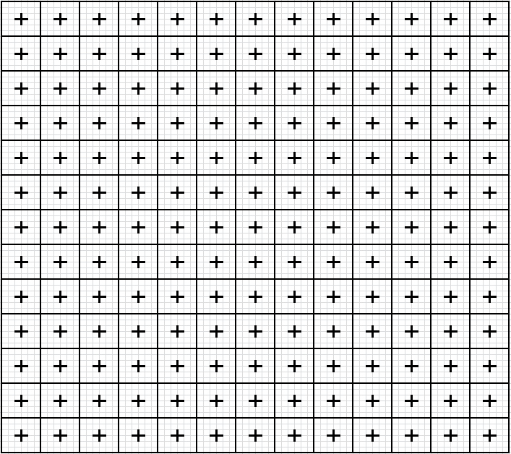
S-102 Why is Grid Resolution Important?
To produce a 1:22K ENC:
Defocus the 1-meter “Navigation Surface” to 6-meters.
554.4 million nodes (1-meter navigation surface)
92.4 millions nodes (6-meter production grid)
Select soundings from the 6-meter grid.
~500 to 1000 soundings make it to a digital chart, or < 1% of the original data.
169 nodal depths
underneath a single
charted sounding
40
20
3.5 mm
or
77 m
real world
*IEC 60945 specifies that character size in mm be not less than 3.5 x the viewing distance in metres. Hence "readable from 1 metre" requires that characters be not less than 3.5 mm in size."
Notes:
s-52 (2014), Appendix 2, 3.1.5 Size of lines, symbols and text; fonts
"The text on the ECDIS should be readable from 1 metre.* Sans serif, non-italic fonts should be used. The computer ø should not be used.
Because several appropriate commercial fonts are available, the Presentation Library does not specify alphanumerics, except for soundings. The manufacturer should make his own arrangements for the use of a font. A plain, clearly readable font such as Univers should be used. In most fonts, pica 8 is too small to read.
*IEC 60945 specifies that character size in mm be not less than 3.5 x the viewing distance in metres. Hence "readable from 1 metre" requires that characters be not less than 3.5 mm in size."

Slide 10
S-102: File Size Limits
Current “Draft” S-102 v2.0 identifies two file size limits:
Datasets must not exceed 10MB for transmission (wireless to platform).
Datasets must not exceed 256 MB for physical media transfer to platform.
HO’s must consider the following to comply with spec.:
Base Record Size for an S-102 File
Grid Resolution
Potential Tilling Scheme

Slide 11
S-102: File Size Limits (NAVO paper exercise)
S-102 Dataset
Compilation Scale | Grid Size
1:10,000,000 | 900 m
1:3,500,000 | 900 m
1:1,500,000 | ????
1:700,000 | 210 m
1:350,000 | 105 m
1:180,000 | 54 m
1:90,000 | 27 m
1:45,000 | 13 m
1:22,000 | 6 m
1:12,000 | 3 m
1:8,000 | 2 m
1:4,000 | 1 m
1:3,000 | 1 m
1:2,000 | 1 m
1:1,000 | 1 m
S-102 Header
4 MB
Depth Layer 1
(True Depth)
8 bytes
Depth Layer 2
(Nominal Depth)
8 bytes
48 bytes
Uncertainty
8 bytes
Vertical Control
24 bytes
Example: a 6-meter grid at 1:22,000 scale
- 12km X 12km (2000 rows x 2000 columns) = 4,000,000 grid cells
- (4,000,000 cells X 48 bytes/cell) / 1,048,000 bytes = 183 MB
- 183 MB + 4 MB (header) = 187 MB

Slide 12
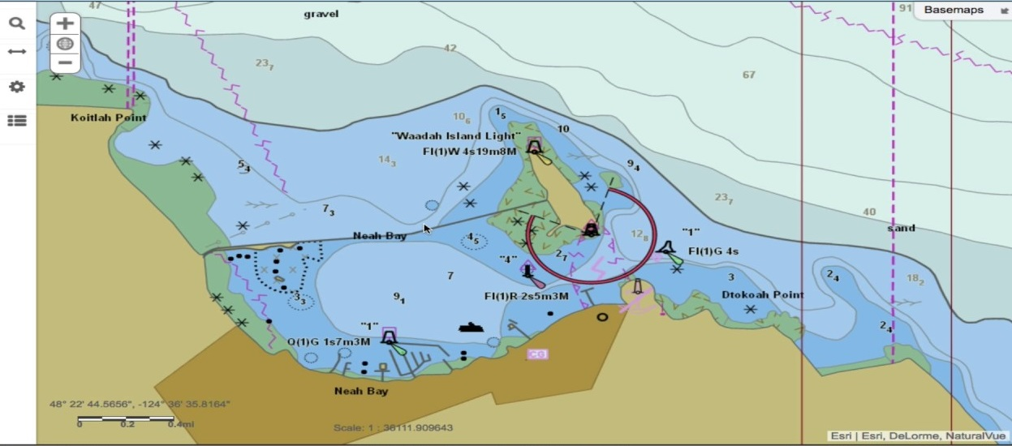

S-102: File Size vs. Tile Size (NAVO paper exercise)
3-meter grid (1:12,000)
(1200 rows X 2300 columns)
~126 MB
Chart Scale | Grid Size
1:10,000,000 | 900 m
1:3,500,000 | 900 m
1:1,500,000 | ????
1:700,000 | 210 m
1:350,000 | 105 m
1:180,000 | 54 m
1:90,000 | 27 m
1:45,000 | 13 m
1:22,000 | 6 m
1:12,000 | 3 m
1:8,000 | 2 m
1:4,000 | 1 m
1:3,000 | 1 m
1:2,000 | 1 m
1:1,000 | 1 m
3.6 km
6.9 km
42 m
~ 100 grid cells
underneath a single 7-meter sounding

Slide 13
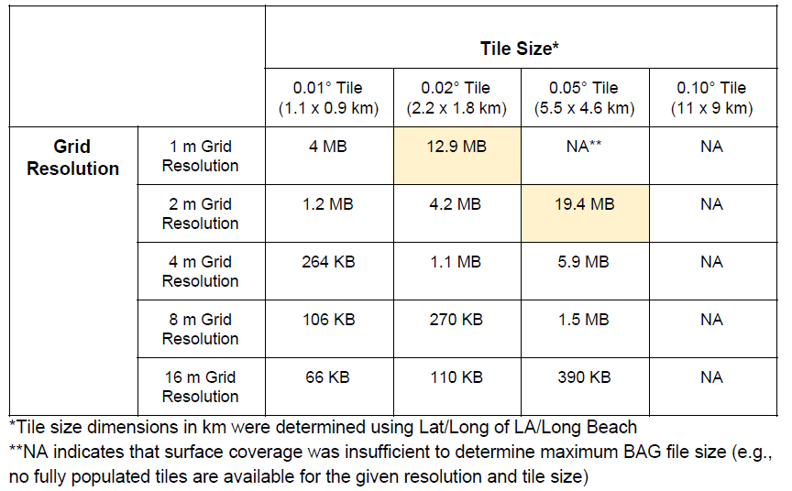
S-102: File Size vs. Tile Size (NOAA Testing)

Slide 14
S-102: Tiling Scheme
< 256 MB
< 256 MB
< 256 MB
< 256 MB
< 256 MB
< 256 MB
< 256 MB
< 256 MB
< 256 MB
< 256 MB
< 256 MB
< 256 MB
< 256 MB
< 256 MB
2300
3-meter S-102 Surfaces
< 256 MB
1-meter S-102 Surfaces
Resolution
Independent
2300

Slide 15
S-102: Coordinate Reference System
Question: Should S-102 utilize geographic or projected CRS?
Geographic CRS
Pros
• S-101 and S-102 product extents will be consistent, since S-101 utilizes geographic CRS (EPSG:4326/WGS84)
• OEMs (ECDIS manufacturers) won’t need to re-project data
Cons
• Inconvenient at higher latitudes
• Requires that positions be reported as floating point numbers; inaccuracies in floating point calculation may yield positional uncertainties in generalization
Projected CRS (e.g., all UTM zones in WGS84)
Pros
• Product boundaries will conform to a regular grid
Cons
• S-101 and S-102 product extents won’t be consistent HOs may have products that cross zones

Slide 16
BAG to S-102 Conversion Script
Original Milestone: US Navy Completes Script by August 2017.
Adjusted Milestone: Complete Script by December 2017.
Post-Development Actions:
US Navy (Naval Oceanographic Office) deliver script to SPAWAR
US Navy (Naval Oceanographic Office) seek Public Release and deliver script to IHO (est. ~ January 2018).
What Does Script Do?
BAG Header
BAG
to
S-102 Script
S-102 Header (converted)
Depth Layer 1
Depth Layer 1 (Original)
Depth Layer 2
Depth Layer 2 (Original)
Uncertainty
Uncertainty (Original)
Vertical Control
Vertical Control (Original)

Slide 17
Remaining Actions: Post S-100 TS-5
Consolidate information from investigation period.
Disseminate this information to entire project team near the end of September 2017.
Obtain final decision from project team (Survey Monkey?)
Establish path for variable-resolution gridding.
Finalize v2.0.0 of the product specification.

